Slide 1
Weekly report: Feedback Controller
Week number: 02
Date: 07/10/2025
Supervisor: Prof. Dr.-Ing. David Schlipf
Group members: Mirza Dincer, Saurabh Pankaj Jha
Presenter: Mirza Dincer

Slide 2
List of Contents
Tasks of the Week
Why IEA 3.4 MW?
ROSCO Workflow
Simulation Settings
Results
Conclusion
Mirza Dincer - 780261

Slide 3
Tasks of the Week
Migrate files of IEA 3.4-MW model to OpenFAST v3.0 and ROSCO v2.6.0 due to them being compatible for Lidar applications
Run Simulation of the IEA 3.4-MW with feedback-only control without Lidar-Assisted controller.
Mirza Dincer - 780261

Slide 4
Why IEA 3.4 MW ?
Rated power capacity: 3.4 MW, designed for utility-scale wind energy generation.
Supports advanced control strategies such as individual pitch control and yaw optimization.
ROSCO implementation allows research-driven improvements and customization for specific turbine control requirements.
Facilitates simulation and testing through OpenFAST.
Clean and well documented example to start.
[1]
Mirza Dincer - 780261

Slide 5
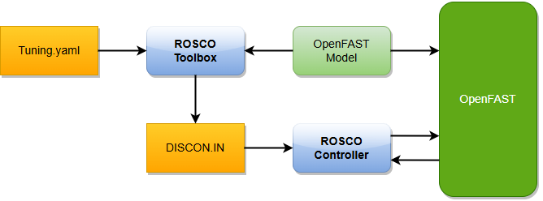
ROSCO Workflow
DLL (Dynamic Link Library)
Linked via ServoDyn.
Manages I/O between OpenFAST and control logic.
IN (Controller Input)
Parameter file for the DLL.
Holds feature flags, modes, gains.
Standard ROSCO workflow showing controller structure and interaction between OpenFAST and ROSCO.
[2]
Mirza Dincer - 780261

Slide 6
Simulation settings
30 seconds of simulation.
Wind speed with 12 m/s, ‘Mexican Hat’ shaped gust up to 15 m/s.
Only enabled Rotor DOF and First fore-aft tower bending-mode DOF.
Set initial conditions of rotor speed, pitch angle, tower top positions. So that turbine starts in steady state.
Running only feedback controller, no Lidar-assisted controller.
Mirza Dincer - 780261

Slide 7
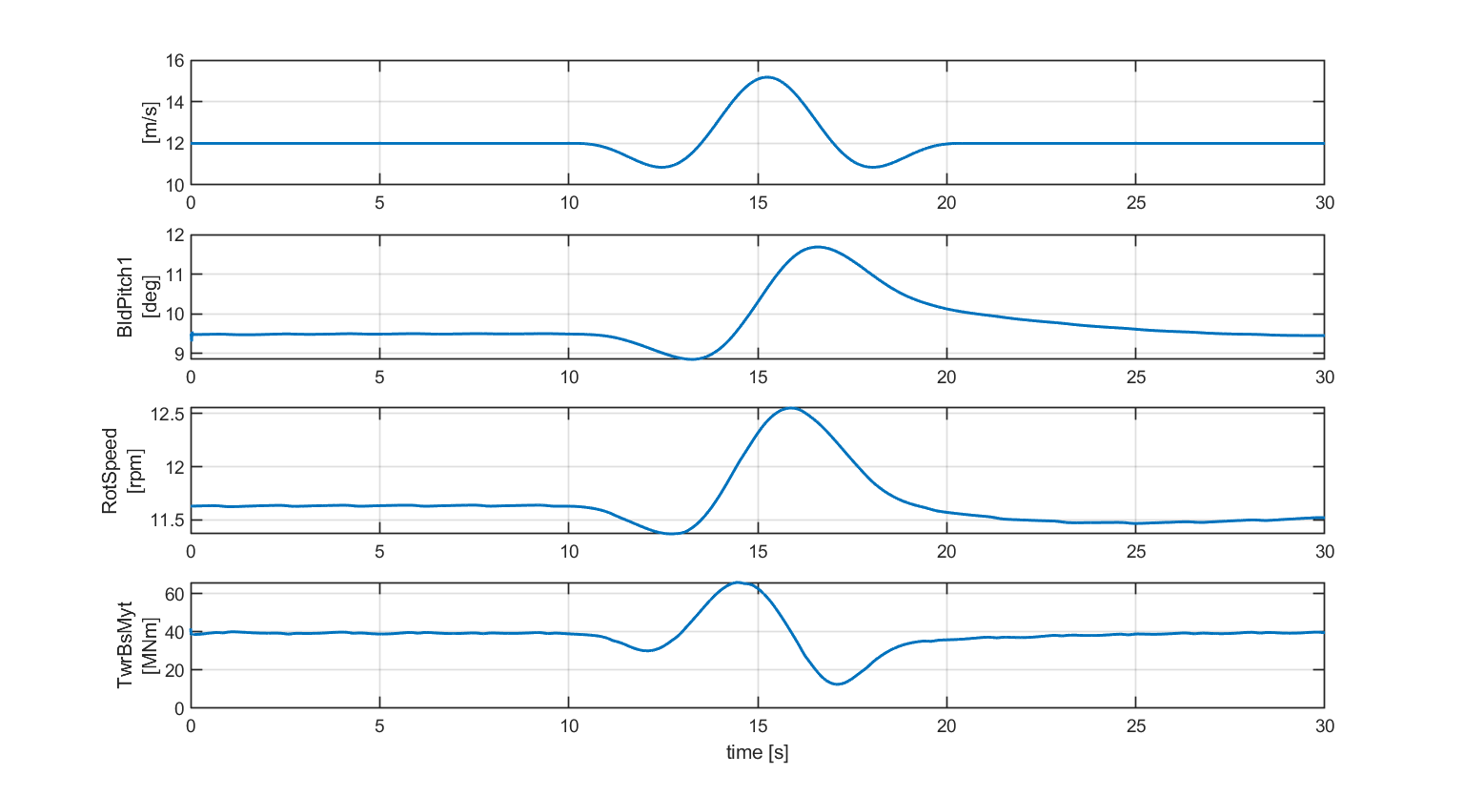
Results
Simulation results for IEA 3.4 MW with feedback control.
Mirza Dincer - 780261

Slide 8
Conclusion
Learned how to couple ROSCO and OpenFAST.
Learned how to update OpenFAST files and ROSCO.
Should discuss with load and dynamics team for OpenFAST version for the project.
Will be updating GitHub simulation files.
Mirza Dincer - 780261

Slide 9
Bibliography – Feedback Controller
[1] P. Bortolotti et al., “IEA Wind TCP Task 37: Systems Engineering in Wind Energy - WP2.1 Reference Wind Turbines,” OSTI OAI (U.S. Department of Energy Office of Scientific and Technical Information), May 2019, doi: https://doi.org/10.2172/1529216.
[2] N. J. Abbas, D. S. Zalkind, L. Pao, and A. Wright, “A reference open-source controller for fixed and floating offshore wind turbines,” Wind Energy Science, vol. 7, no. 1, pp. 53–73, Jan. 2022, doi: https://doi.org/10.5194/wes-7-53-2022.

